Slide 1
Installation Guide
(Eclipse Plug-in － IAM (q4e) 0.10.0
on Eclipse 3.5)
2009. 07. 21
CODELABOR
Shin Sang Jae (codelabor@gmail.com)

Slide 2
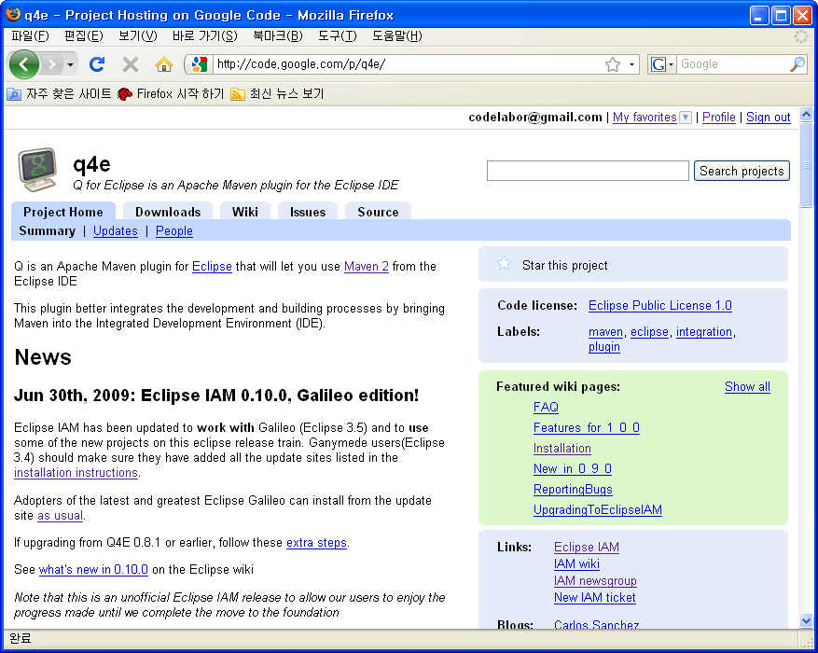
IAM
Update
Officical Site: http://code.google.com/p/q4e/

Slide 3
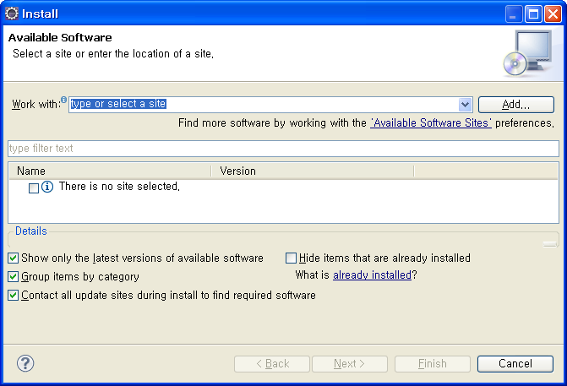
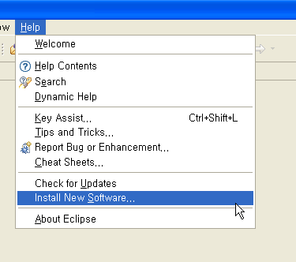
IAM
Install
Menu
  Help > Install New Software...
Install Window
  Work With: > Add

Slide 4
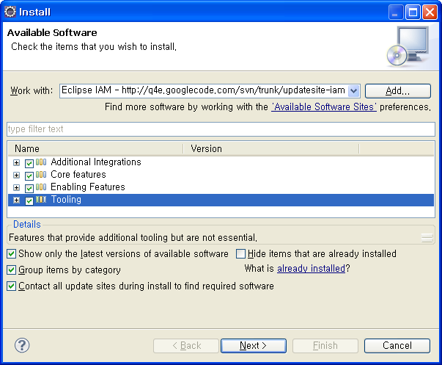
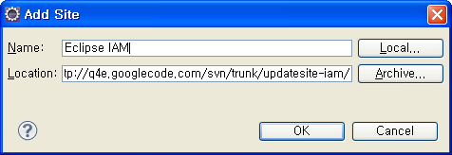
IAM
Add Site
Add Site Windows
  Name: Eclipse IAM
  Location: http://q4e.googlecode.com/svn/trunk/updatesite-iam/
  Check All Items

Slide 5
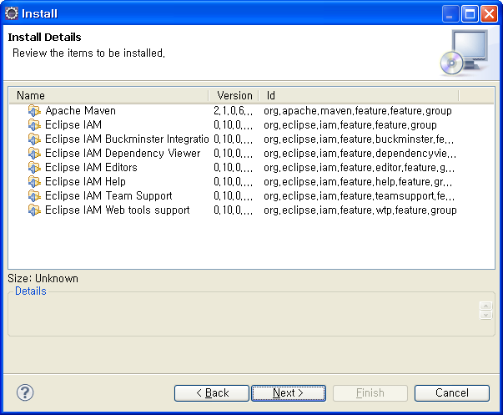
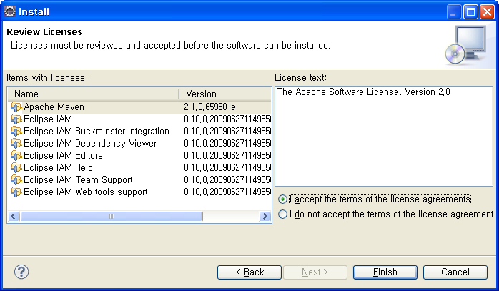
IAM
Install
Install Details Window
Accept the terms of the license agreements

Slide 6
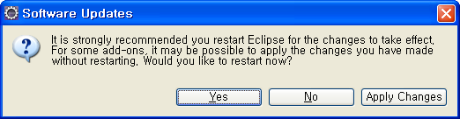
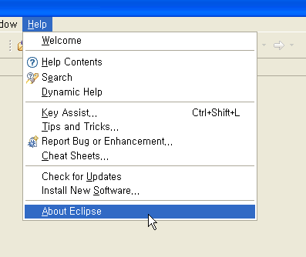
IAM
Software Updates
Software Updates Window
  Restart
Menu
  Help > About Eclipse

Slide 7
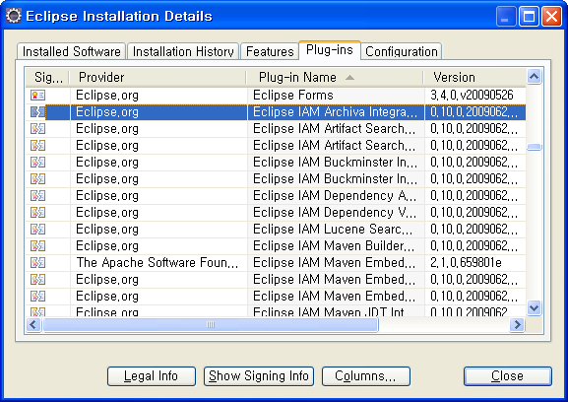
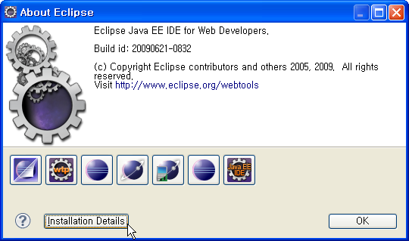
IAM
Software Updates
About Eclipse Window
  Install Details
Eclipse Installation Details Window
  Plug-ins

